Slide 1
CISC 525 Final Project
Impact of the COVID-19 Pandemic on Crime Rates in Los Angeles, California
Submitted To: Prof. Sangwhan Cha
Submitted By: Bhargav Kotipalli Sai Krishna Teja Kancharla Tushar Shirish Kulkarni Yoon Ho Kim
Due Date: Nov 29, 2023

Slide 2
Table of Content
Motivation
Problem Statement
Dataset Description
Dataset
System Architecture
Data Processing
Data Visualization
Result

Slide 3
Problem Statement
Objective
To investigate and analyze the impact of the COVID-19 pandemic on crime rates in Los Angeles, California, and assess whether any significant changes occurred.
Problem Statement
The COVID-19 pandemic disrupted normal societal patterns, potentially influencing criminal activities. We aim to determine if there was a statistically significant change in crime rates during the pandemic, which can inform policy decisions regarding resource allocation in emergency situations.

Slide 4
Motivation
The COVID-19 pandemic was an unprecedented global crisis, affecting all aspects of life.
We are driven by curiosity to understand how such crises impact society, including crime rates.
Key Points:
Societal Resilience & Adaptation: Explore how societies adapt to crises and the resilience of communities and law enforcement.
Resource Allocation: Inform resource distribution during emergencies by studying changes in crime rates.
Policy Implications: Aid policymakers in resource allocation, law enforcement priorities, and public safety strategies.
In essence, this project is motivated by the desire to unravel the complex web of factors that influence crime rates during a global pandemic like COVID-19. By doing so, we aim to contribute to the body of knowledge that guides both immediate crisis management and long-term strategies for a more resilient and secure society.

Slide 5
Dataset Description
Crime Data from 2020 to Present
Source: https://catalog.data.gov/dataset/crime-data-from-2020-to-present
Published by the City of Los Angeles
Record of all crimes occurred at the city of Los Angeles from January 2020 to September 2023
Each case record includes
Reported date
Location, time, and date of crime occurred
Crime type
Shoplifting
Type of weapon used, if any
Age, sex, and descent information about the victim

Slide 6
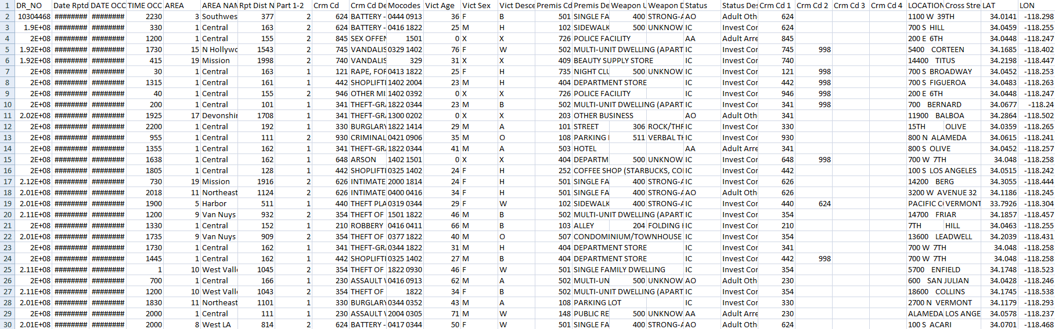
Dataset
Dataset with first 30 rows of data as a reference.

Slide 7
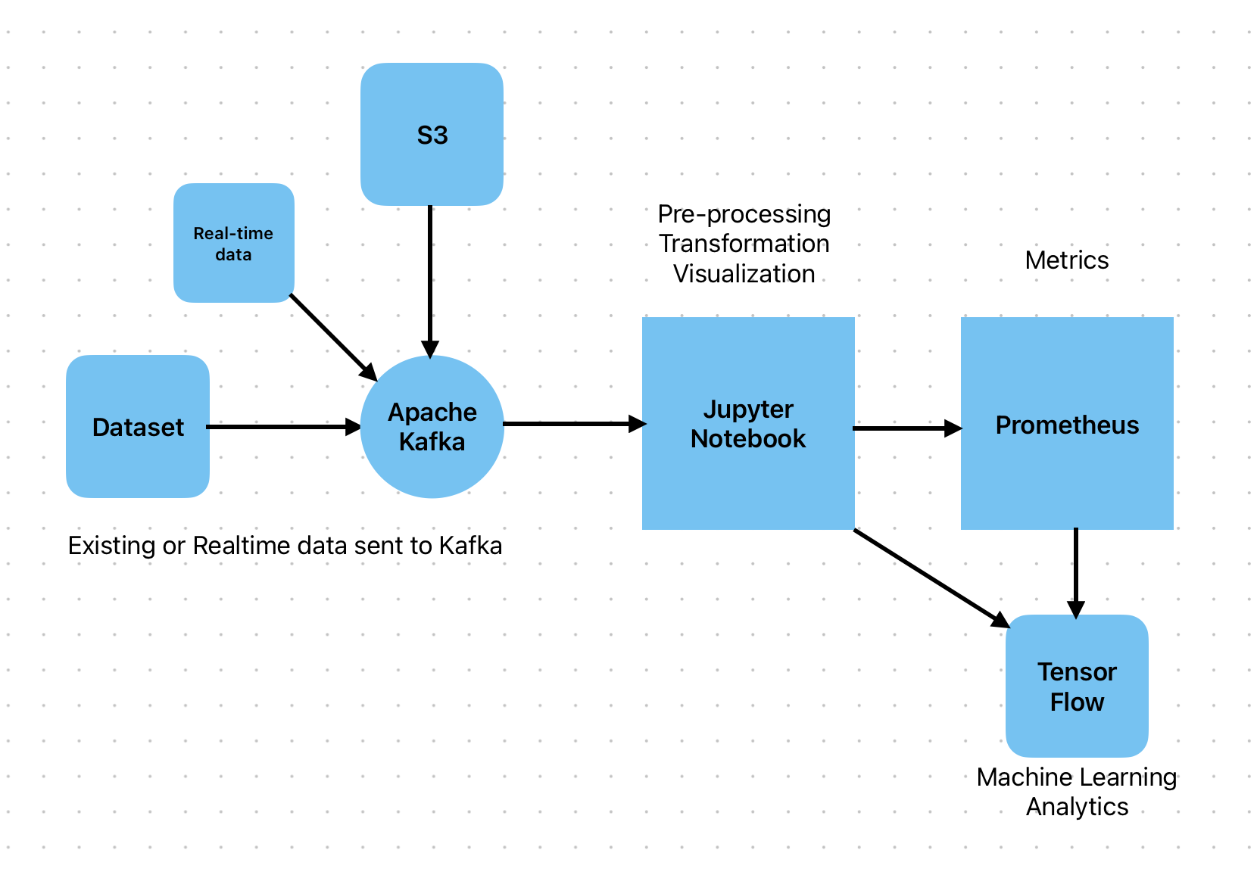
System Architecture

Slide 8
System Architecture
All the existing data and real-time data will be published to Kafka.​
A python program to consume data from kafka and use it in the jupyter notebook where we do the data preprocessing and visualizations.​
The data will then be sent to Prometheus for performing analytics and to monitor the metrics.​
The parallel data is sent to tensor flow for machine learning purposes where we train a model to do predictions.​
The tools Kafka, Jupyter notebook, Prometheus and TensorFlow are done and used in local machine.​

Slide 9
Data Processing
# Define the phases: before, during, and after the pandemic before_pandemic = data[data['Date Rptd'] < pd.to_datetime('03/01/2020', format='%m/%d/%Y')] during_pandemic = data[ (data['Date Rptd'] >= pd.to_datetime('03/01/2020', format='%m/%d/%Y')) & (data['Date Rptd'] <= pd.to_datetime('06/01/2021', format='%m/%d/%Y')) ] after_pandemic = data[data['Date Rptd'] > pd.to_datetime('06/01/2021', format='%m/%d/%Y')]
Data categorized into three time periods:
Before Pandemic
01/01/2020 - 03/01/2020
During Pandemic
03/01/2020 - 06/01/2021
After Pandemic
06/01/2021 -

Slide 10
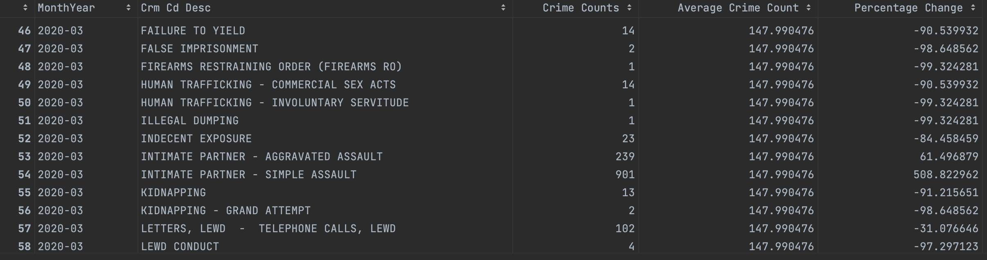
Data Processing
Monthly crime counts by crime code

Slide 11
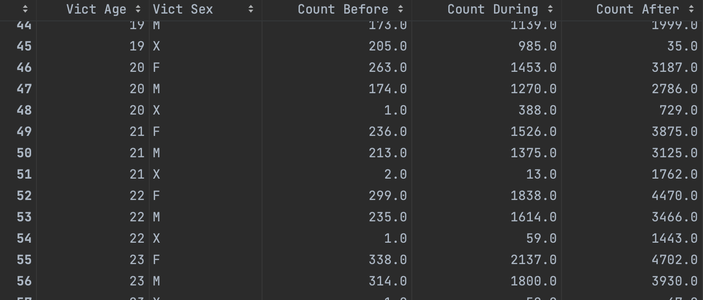
Data Processing
Demographic background of crimes

Slide 12
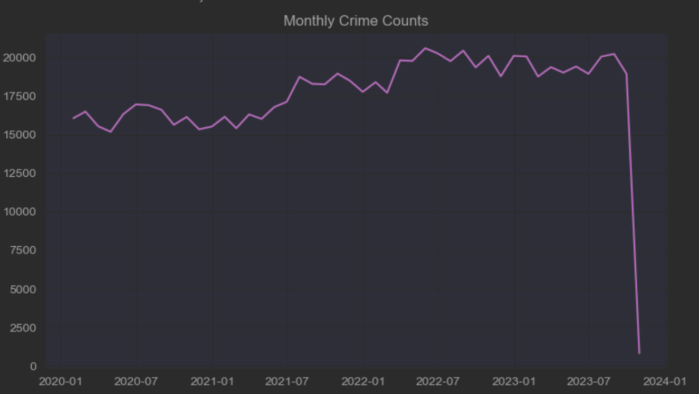
Data Visualization
Monthly crime counts

Slide 13
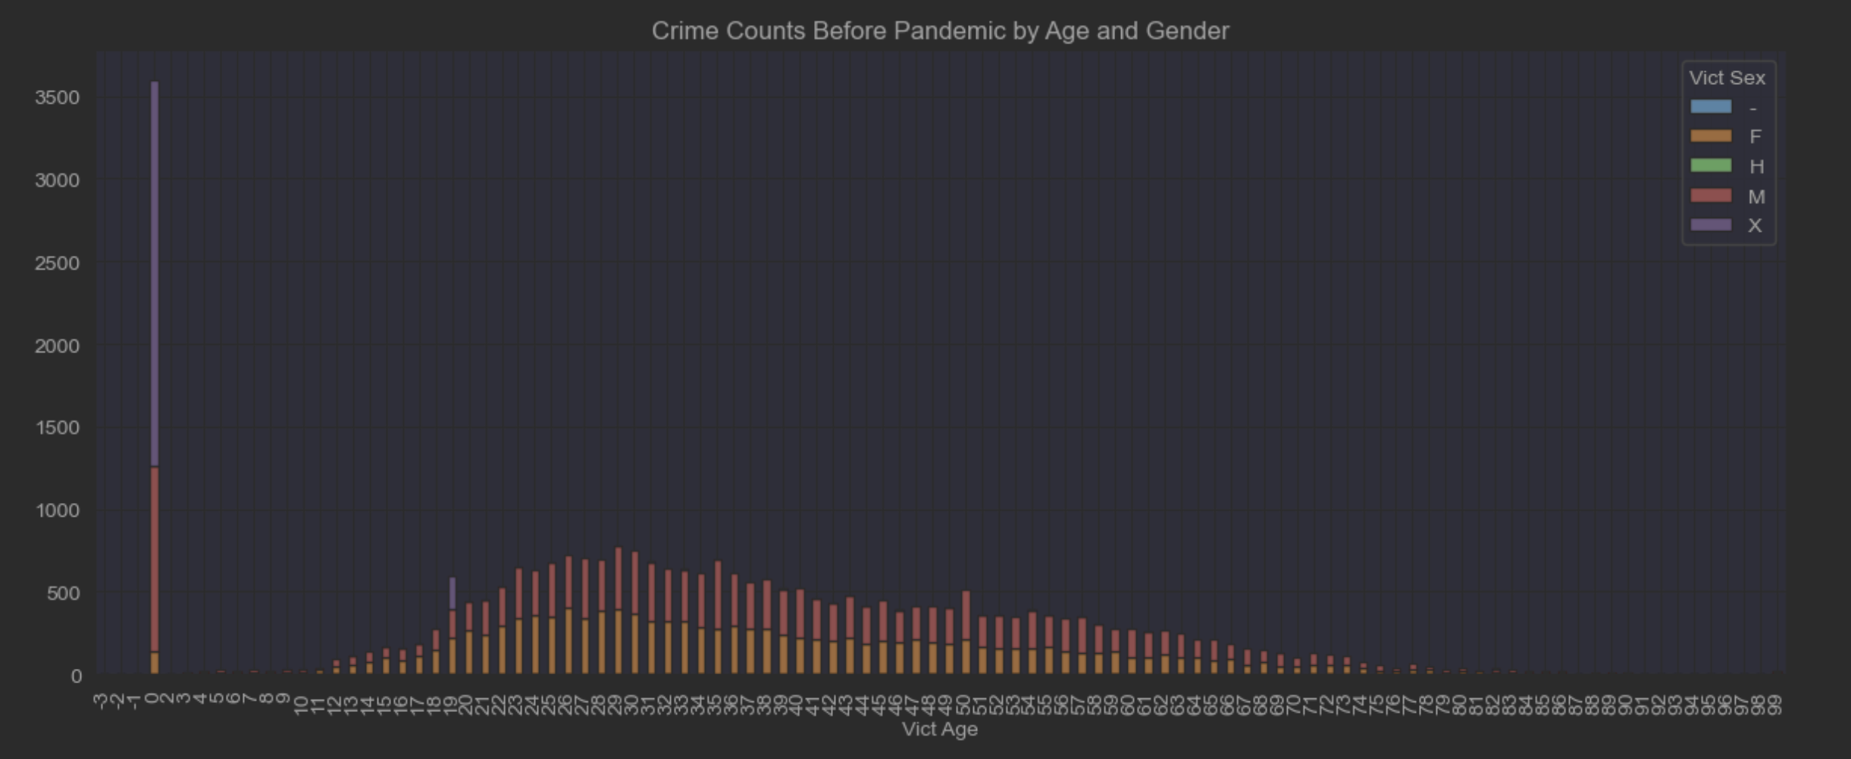
Data Visualization
Crime counts by Age and Gender, Before Pandemic (01/01/2020 - 03/01/2020)

Slide 14
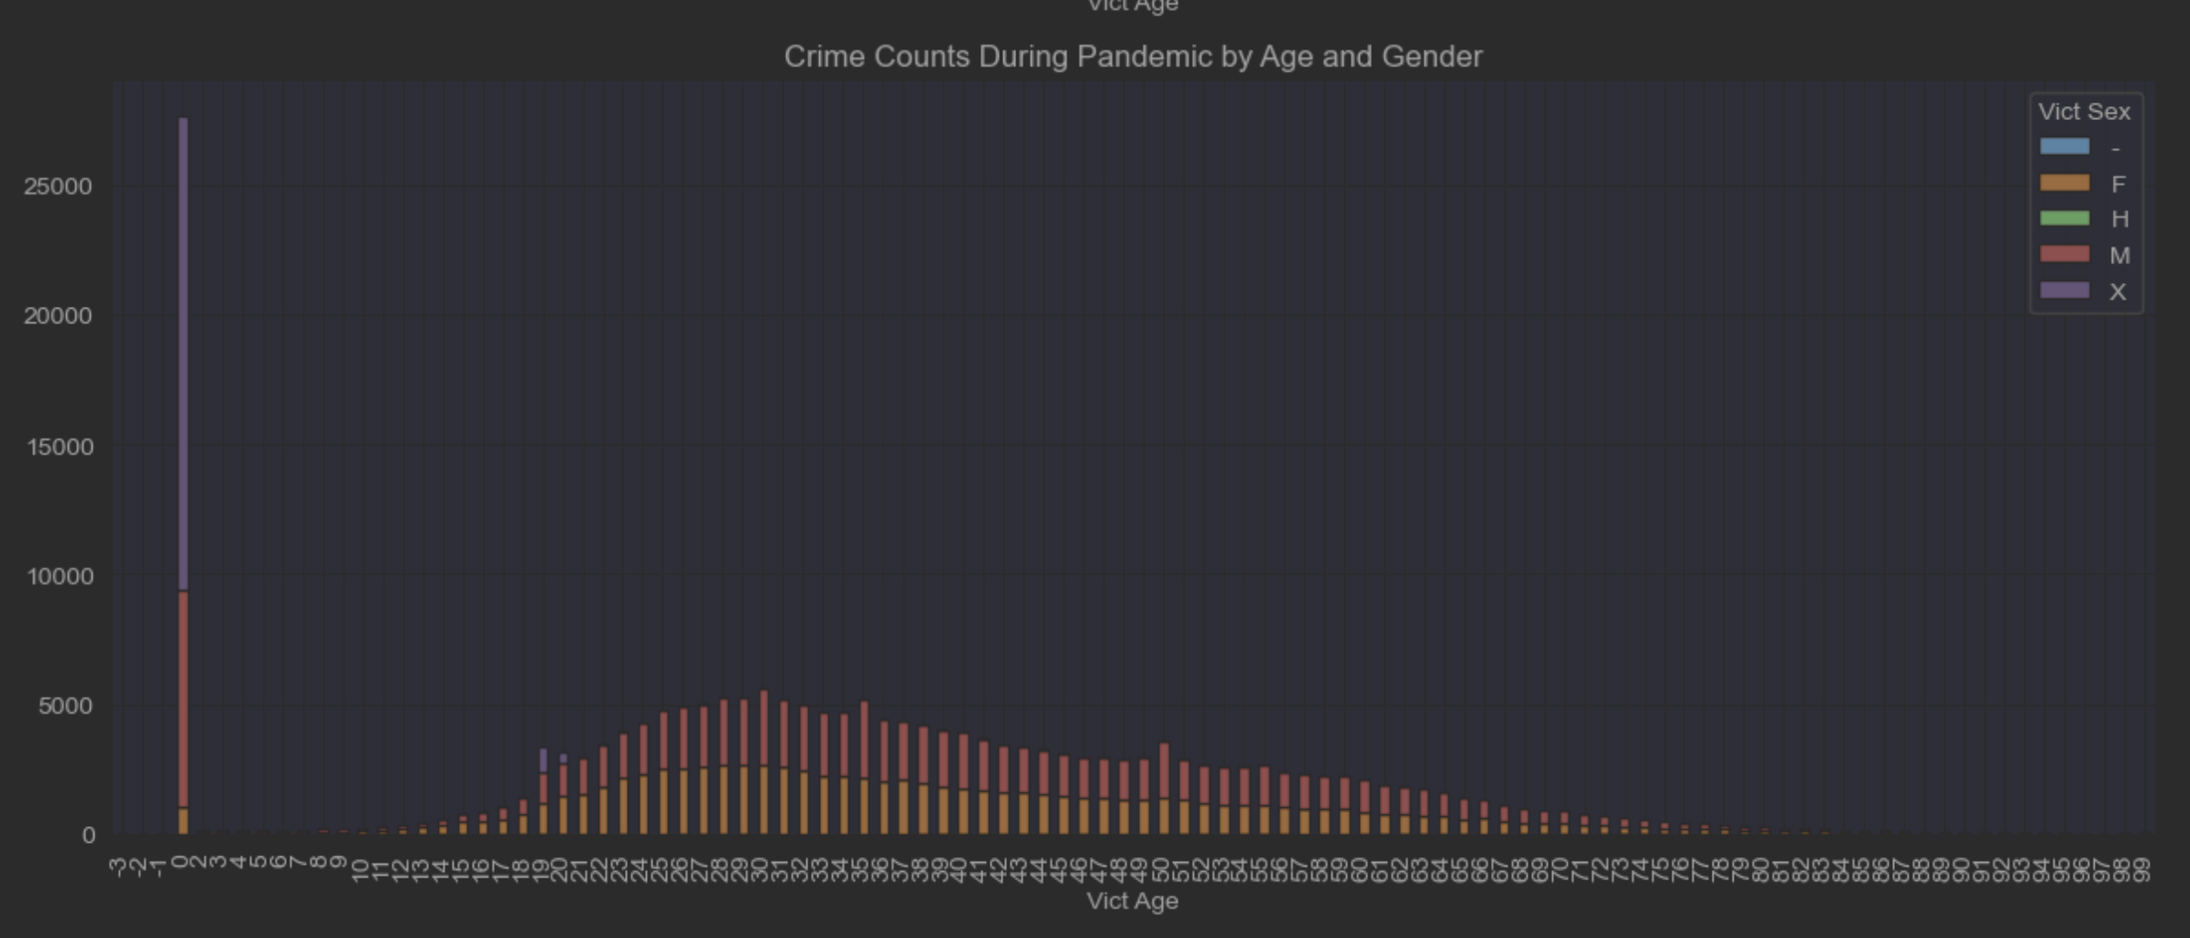
Data Visualization
Crime counts by Age and Gender, During Pandemic (03/01/2020 - 06/01/2021)

Slide 15
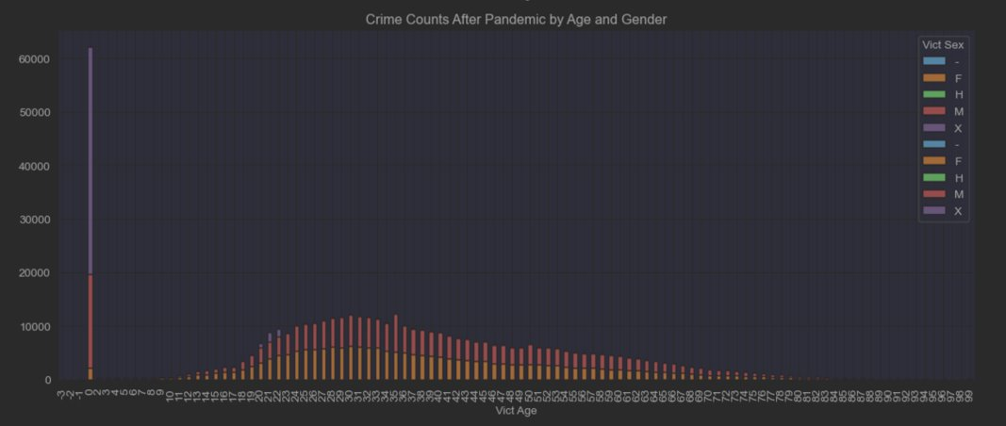
Data Visualization
Crime counts by Age and Gender, After Pandemic (06/01/2021 - )

Slide 16
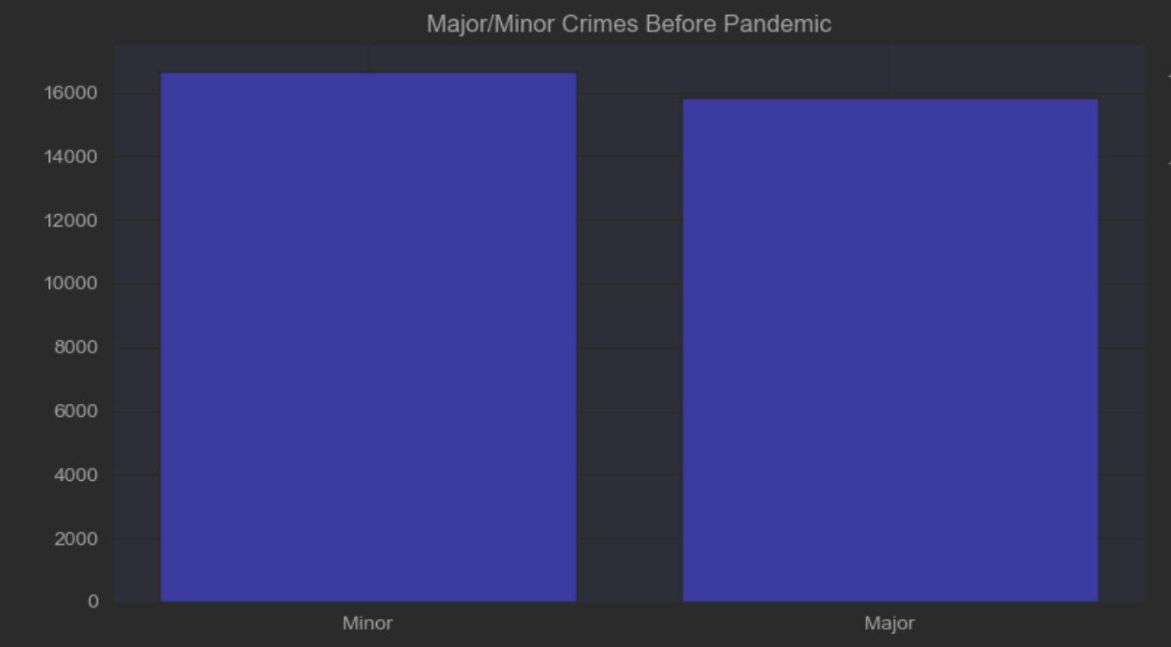
Data Visualization
Major(Crime code > 500) & Minor(Crime code <= 500) crime counts , Before Pandemic (01/01/2020 - 03/01/2020)

Slide 17
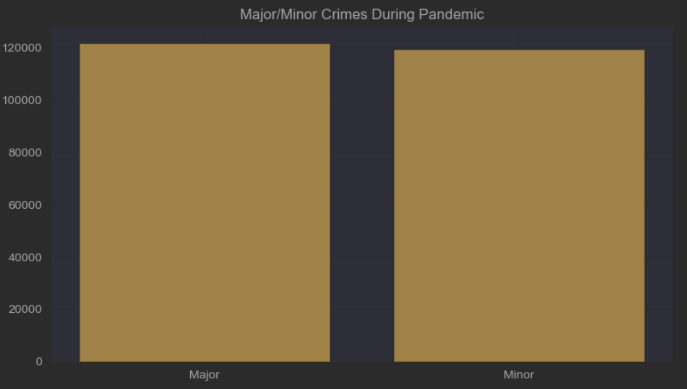
Data Visualization
Major(Crime code > 500) & Minor(Crime code <= 500) crime counts, During Pandemic (03/01/2020 - 06/01/2021)

Slide 18
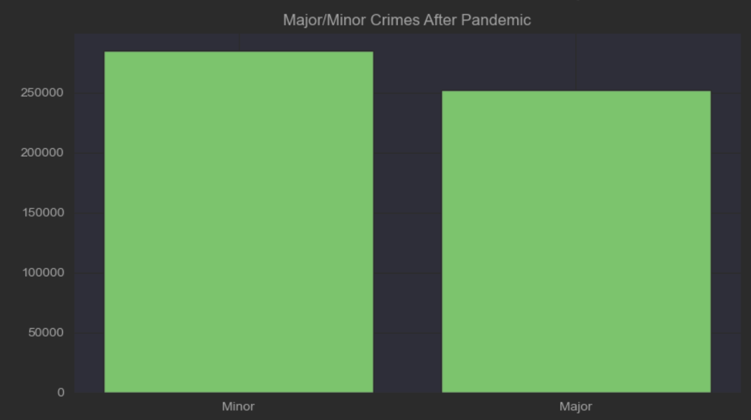
Data Visualization
Major(Crime code > 500) & Minor(Crime code <= 500) crime counts, After Pandemic (06/01/2021 -)

Slide 19
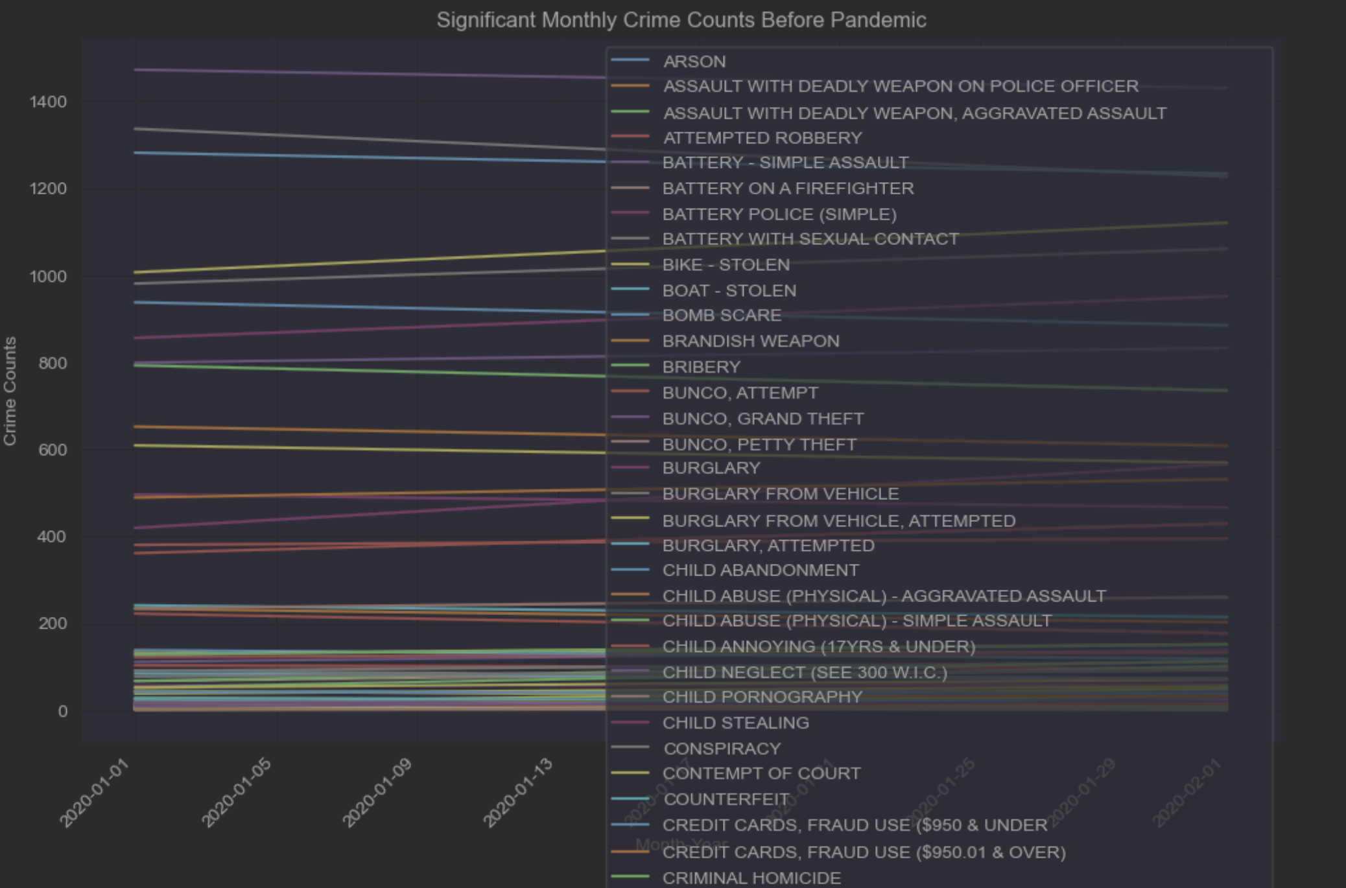
Data Visualization
Significant Crime Counts, Before Pandemic (01/01/2020 - 03/01/2020)

Slide 20
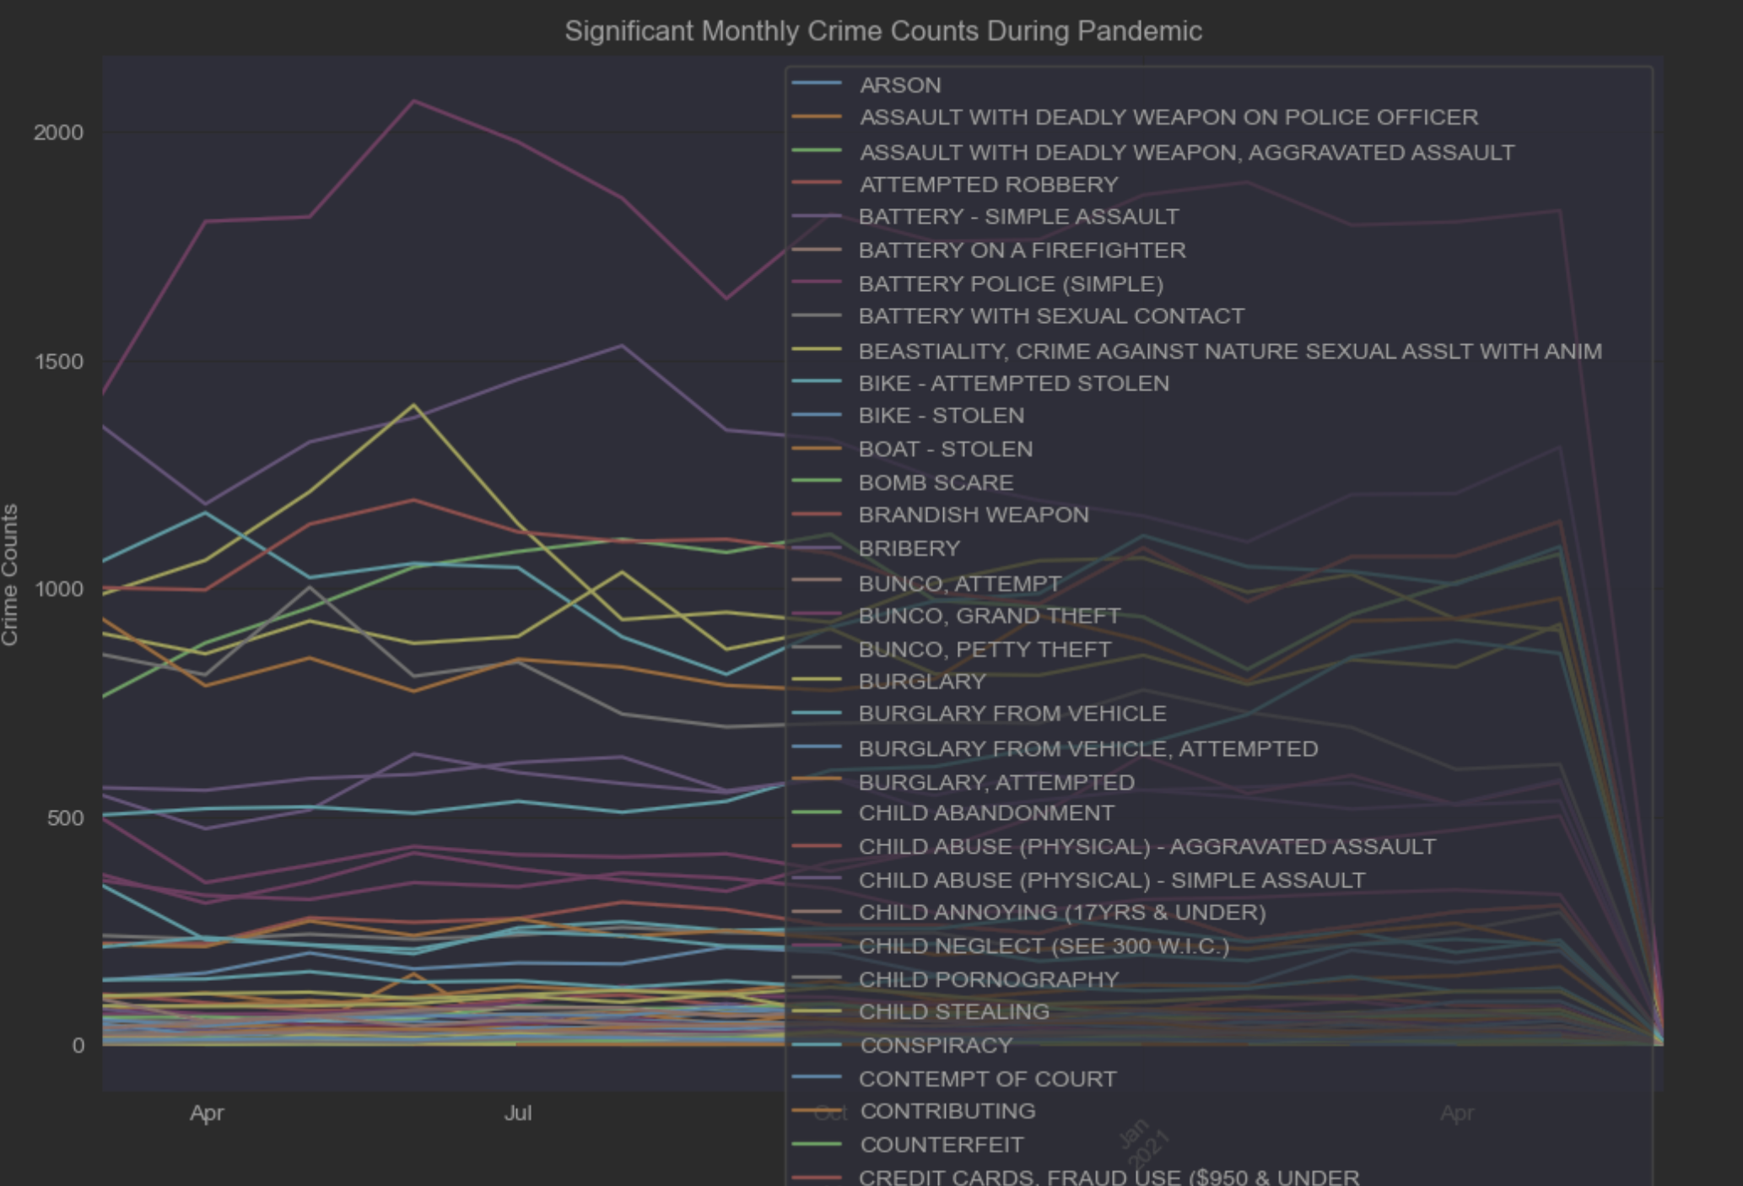
Data Visualization
Significant Crime Counts, During Pandemic (03/01/2020 - 06/01/2021)

Slide 21
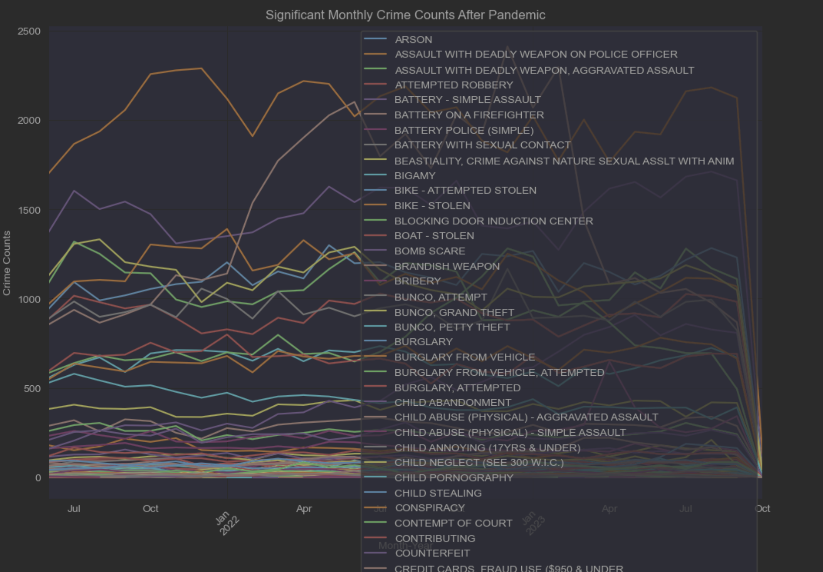
Data Visualization
Significant Crime Counts, After Pandemic (06/01/2021 - )

Slide 22
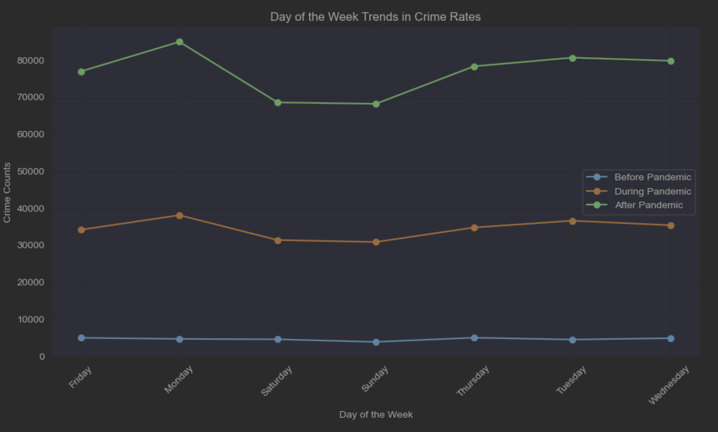
Data Visualization
Day of the Week Trends in Crime Rates

Slide 23
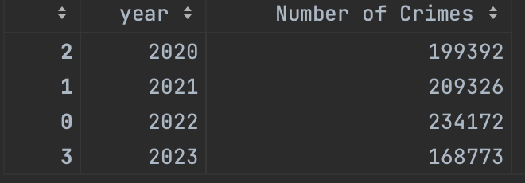
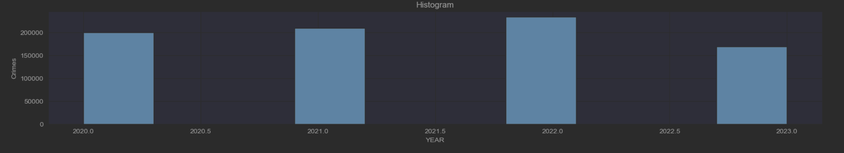
Results
An increasing trend for the crime rate, regardless of the pandemic period
No change in trend observed for the demographic background of each crime with regards to pandemic period
While theft was the most common crime type committed at all time, the most common type of theft committed differed by pandemic period
Ex – car theft after pandemic
During and after pandemic periods showed an increased crime rate on Monday

Slide 24
Reference
City of Los Angeles. (2023, November 24). Crime data from 2020 to present. Data.gov. https://catalog.data.gov/dataset/crime-data-from-2020-to-present

Slide 25
CISC 525 Final Project
Questions?

